Slide 1
NumPy
Linear Algebra

Slide 2
Linear Regression

Slide 3
equation of a line
y = mx + b

Slide 4
equation of a line
y = mx + b
linear regression
y = β0 + β1x

Slide 5
Simple Linear Regression
Input learned coefficients output
(weights)
x1 β0 , β1 y
y = β0 + β1x

Slide 6
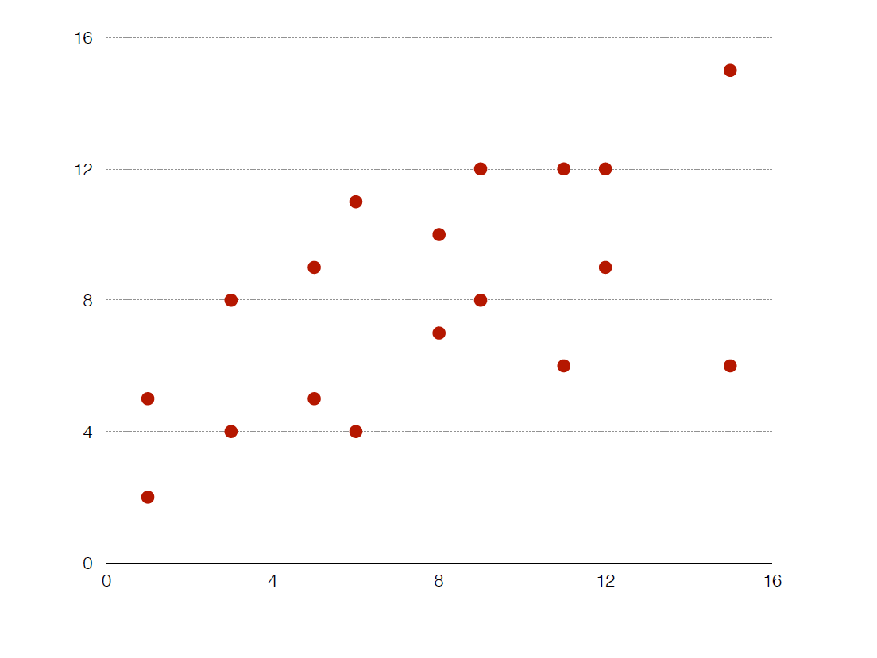

Slide 7
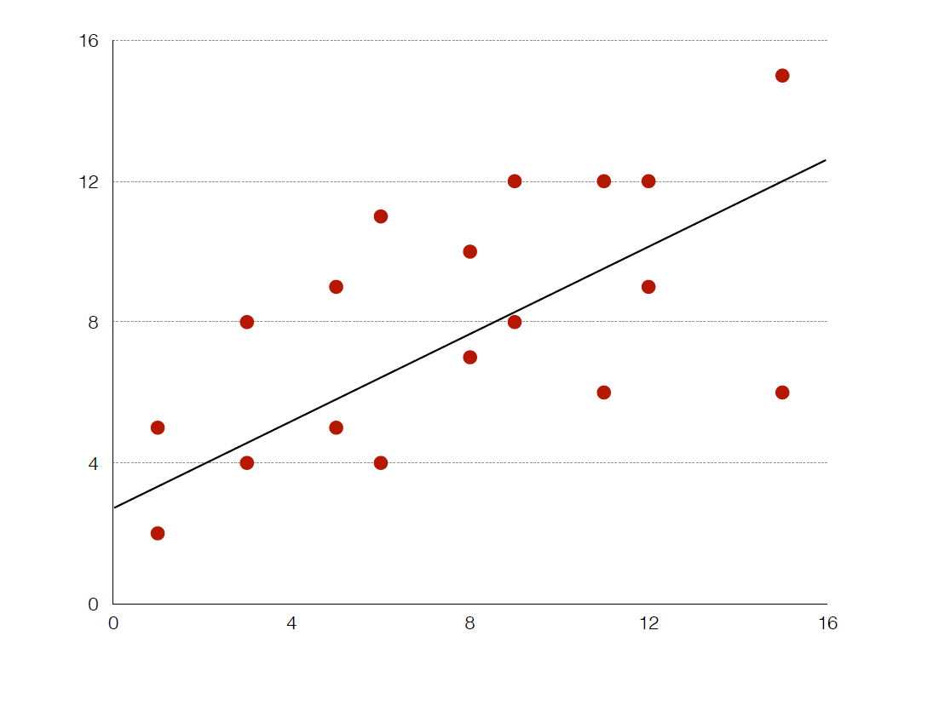

Slide 8
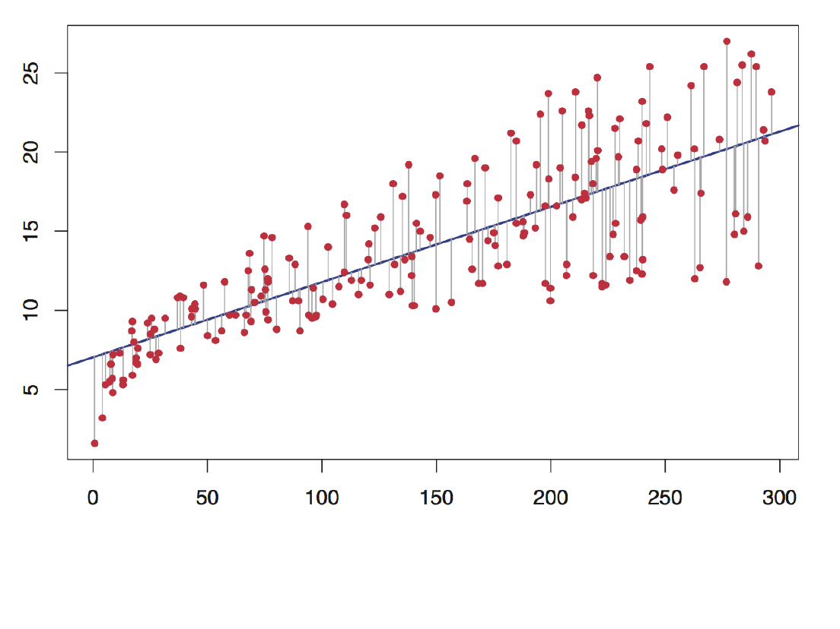

Slide 9
Multiple Linear Regression
LOC = 227.63 + 9.51x1 + 2.7x2 – 7.08x3
x1 = hour of pair programming
x2 = gender (m=0, female=1)
x3 = number of social accounts

Slide 10
Multiple Linear Regression
LOC = 225 + 10x1 + 3x2 – 7x3
x1 = hour of pair programming
x2 = gender (m=0, female=1)
x3 = number of social accounts

